Slide 1
Reddit and yahoo finance data analysis
Dave Burgman, Ian Lee, Navdeep Kaur, April Holmes, Chris Avallon

Slide 2
OVERVIEW
This project retrieves data from Yahoo Finance and Reddit, performs analysis, and visualizes the relationship between Reddit upvotes and comments. It also fetches historical stock data for a specific symbol from Yahoo Finance and conducts a linear regression analysis. This project involves the analysis of data from the Wall-Streeters' subreddit on Reddit and financial data from Yahoo Finance, focusing on Tesla, Inc.
Goal: To explore potential correlations between Reddit post engagement (upvotes and comments) and stock market performance.

Slide 3
hypothesis
Alternate Hypothesis
Social media activity (within a specific Reddit community) surrounding a company is correlated to stock performance
Null Hypothesis
Social media activity does not correlate to stock performance

Slide 4
DATA SOURCES
YAHOO Finance
Quality of Data: Based on professional finance experience within our group, Yahoo Finance has always been a popular source of large, reliable, and accurate finance data within the industry. As a result of this knowledge, we explored the API options for Yahoo Finance and we were able to get a free API from rapid API (Base URL = https://yahoo-finance127.p.rapidapi.com/price/
Parameters: We added additional parameters to our Base URL based on the documentation we researched for the Yahoo Finance API, which includes the stock symbol.
Stock Symbol – This is the ticker symbol that we search via the API. Set to enable the user to input any ticker symbol they would like.
Additional Info - second URL (https://yahoo-finance127.p.rapidapi.com/historic/{stock_symbol}/1d/1000d), used to obtain additional historical price data associated with the ticker symbol being searched.

Slide 5
DATA SOURCES
Reddit
Quality of Data: Reddit was selected as a source due to the role it played in January 2021 with GameStop stock (https://en.m.wikipedia.org/wiki/GameStop_short_squeeze).
In summary, the Wall Street Bets subreddit forum from Reddit caused the price of GameStop to go to $500 per share (about 30 times the $17.25 valuation of the stock).
Reddit API can also focus on any subreddit of our choice. Based on the history of the Wall Street Bets subreddit, we focused on that one. The initial base URL for Reddit: https://www.reddit.com/api/v1/access_token.
Parameters: We added additional parameters to our Base URL based on the documentation we researched for Reddit, but included a Python Reddit API Wrapper (AKA; PRAW) to give us easier access to the data needed for this project.
Reddit Posts– We used our parameters to search each post for the following data; Title, Upvotes, Keyword Term, Number of Comments Received, and Date Created.
Additional Info – When searching the posts, we set a limit of 1000 posts, starting with the newest post. The Keyword term is the company name, which we set as an input by the user.

Slide 6
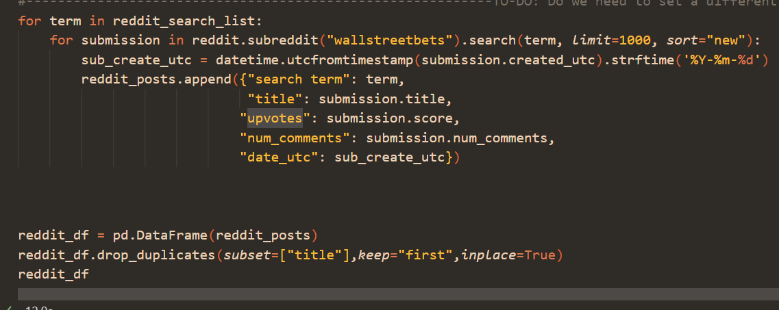
Data exploration and cleaning (reddit)
Social media search
Api packages
Google
Youtube
RedditAPI
praw
API wrapper

Slide 7
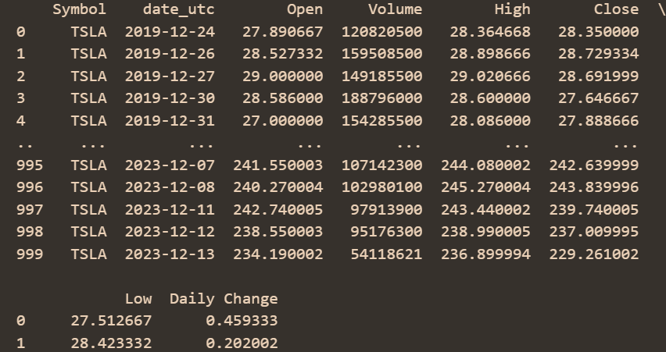
Data exploration and cleaning (Yahoo)
Rapid api
Extracting data
Merging
Yahoo Finance API
API Key
URL
pd.merge(reddit_df, yahoo_finance_df)
Testing data
Removing outliers
Sorting dates

Slide 8
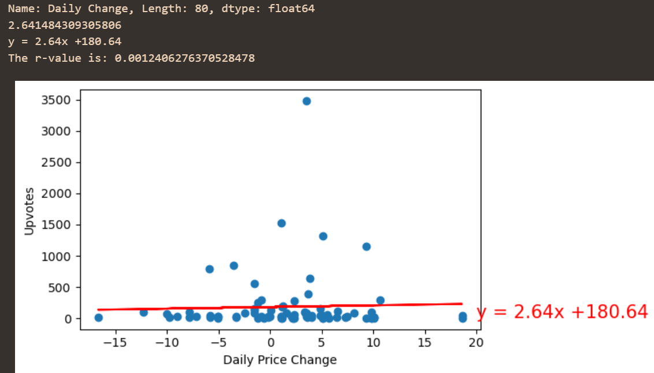
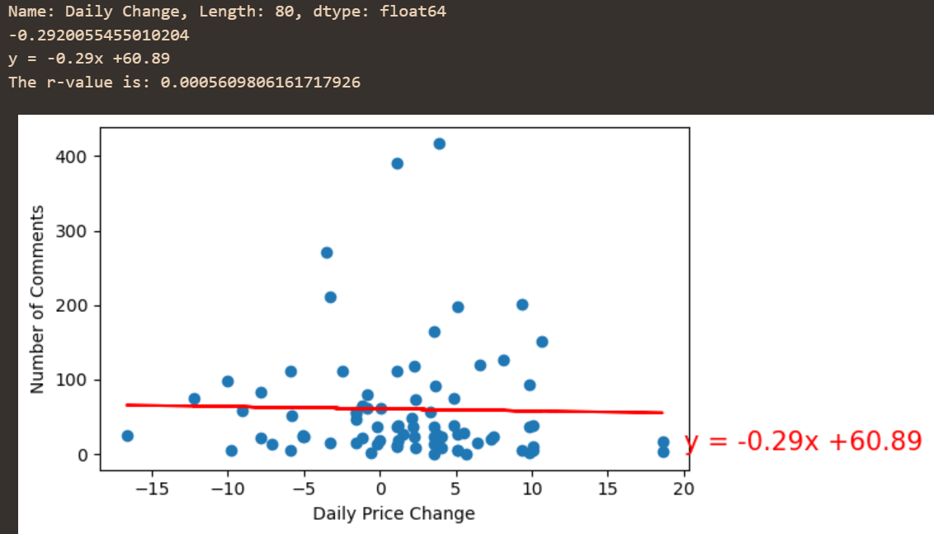
Graph Correlations
Daily Price Change: X
Upvotes: Y
Daily Price Change: X
Number of COmments: Y

Slide 9
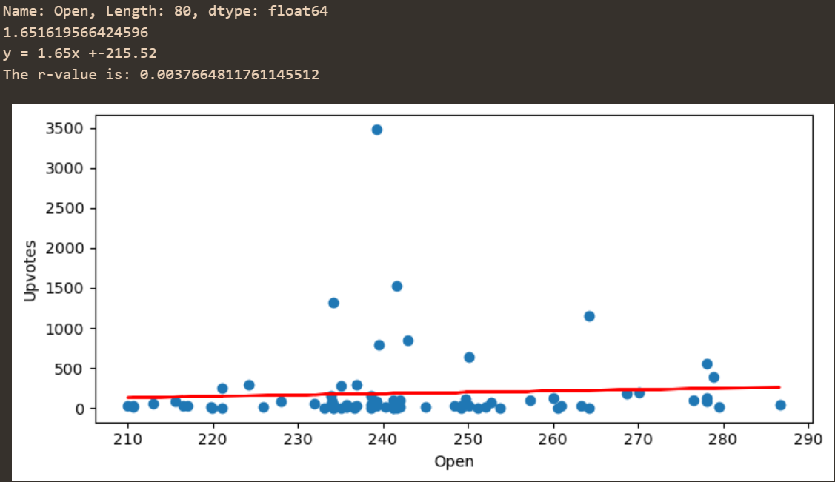
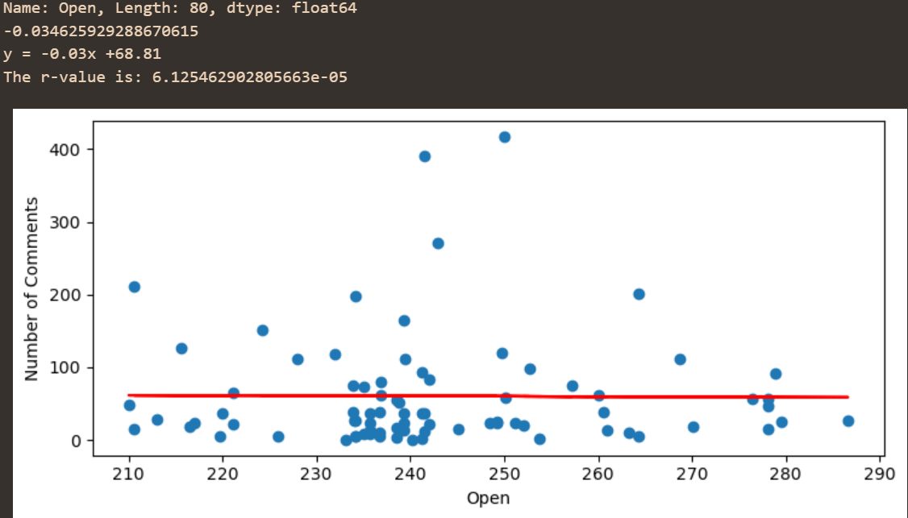
Graph Correlations
Open: X
Upvotes: Y
Open: X
Number of COmments: Y

Slide 10
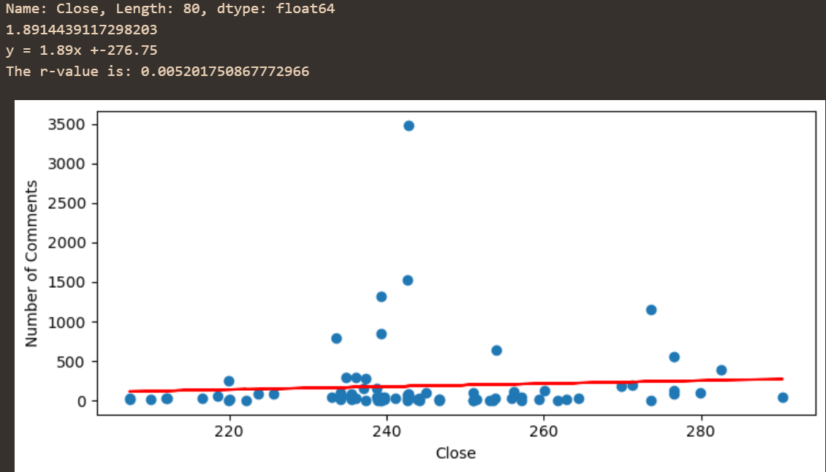
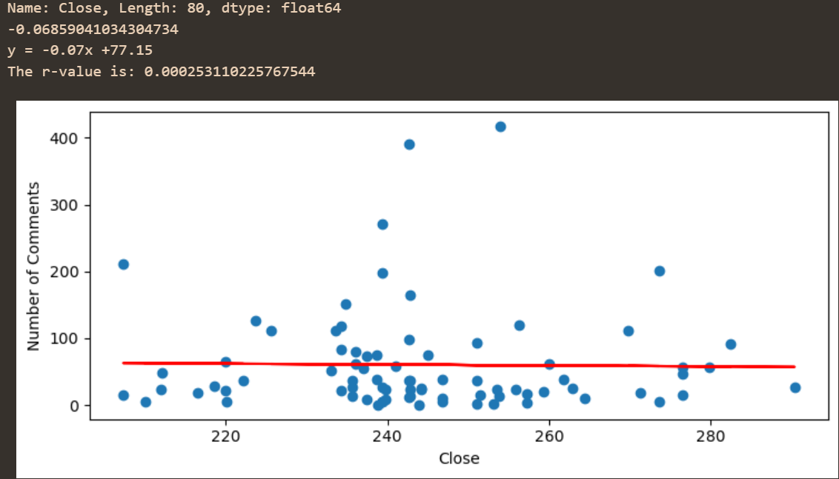
Graph Correlations
CLOSE: X
Upvotes: Y
CLOSE: X
Number of COmments: Y

Slide 11
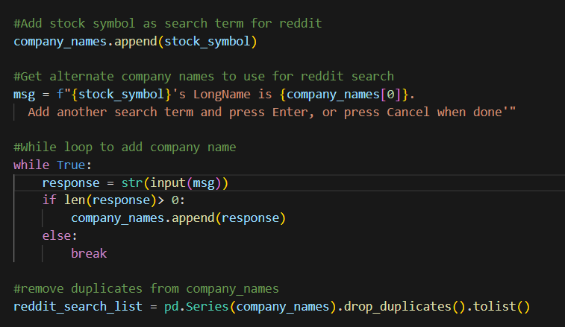
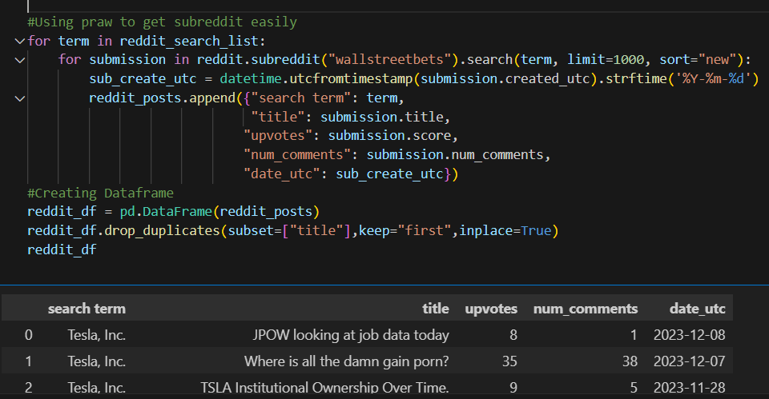
Data Cleaning
Ticker/Company selection
- For flexibility, added an input prompt to set stock ticker to search and added the option to input additional company names. (Ex. TSLA ticker, company name is “Tesla, Inc”. You can add “Tesla”)
- As part of data cleaning, removed any duplicates entered before searching.
Date formatting
For both Yahoo and Reddit, converted dates from timestamp to a more common date format (Ex 1706007540 to 2024-01-23)

Slide 12
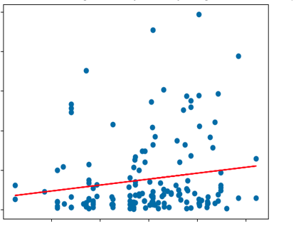
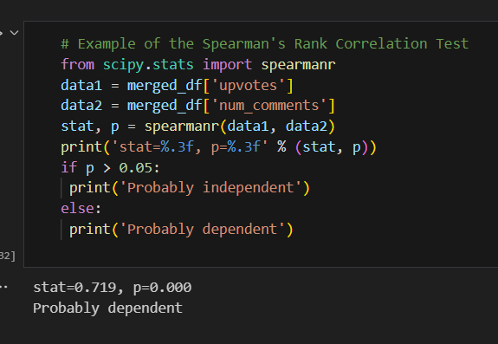
Data analysis
Reddit mentions vs stock price
From Yahoo, extracted key financial indicators for a selected stock (TSLA) and obtained historical stock price data for the past 100 days.
From Reddit, conducted a search for posts containing the ticker or company name and extracted number of comments and upvotes to determine mentions.
Conducted a linear regression analysis on the selected stock’s daily change vs. comments to explore their relationship. Ran Spearman’s Rank Correlation Test to determine dependency.

Slide 13
conclusions
Reddit Engagement vs. Stock Performance: Analyzed the relationship between Reddit post engagement and Tesla stock performance. The linear regression analysis suggests a positive correlation between upvotes and comments, indicating higher engagement for certain stock-related posts.
Historical Stock Performance: Explored historical stock prices for Tesla, Inc. over the past 100 days. Visualized trends and patterns in the stock's performance.

Slide 14
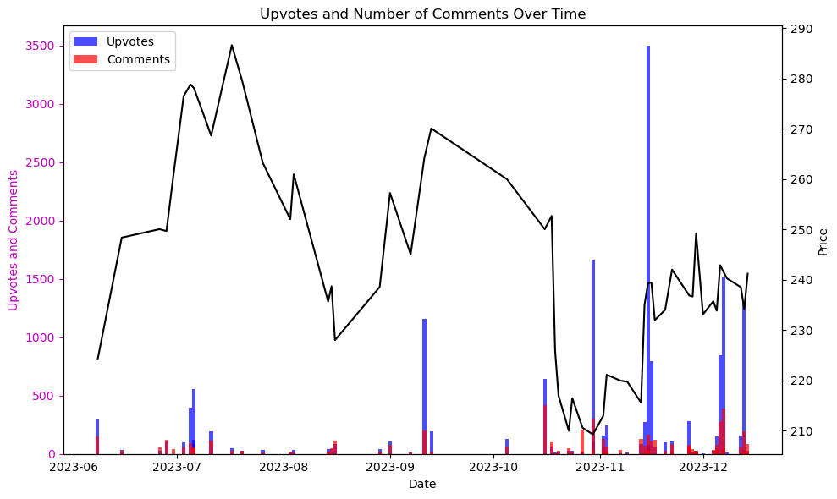
conclusions
Price change and frequency of mentions seem to have only a slight correlation, however the topography of price changes and social media mentions are similar
Using live data which tracks mentions rather than sentiment, the statistical correlation between the two datasets will be constantly changing. However, we can still use this visualization to track social media’s impact on historical price movement as well as the inverse (price movement affecting frequency of mentions) and use this information to find sleeper stocks, identify targeted price manipulation, and predict trades within the market and amongst members of WallStreetBets

Slide 15
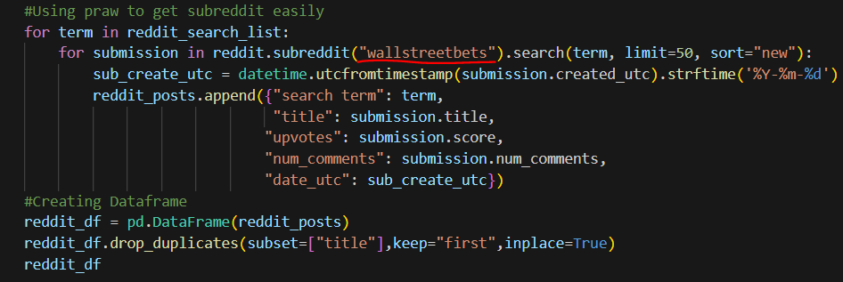
implications
Suggestions for further analysis
Sentiment Analysis: Incorporate sentiment analysis on Reddit comments to understand the overall sentiment of the community towards specific stocks.
Volume Analysis: Explore the correlation between stock trading volume and Reddit engagement to identify potential trends or anomalies.
Reddit comments and upvotes are a low-confidence indicator of price movement on the stock market
Price manipulation by the WallStreetBets group can be visualized by tracking the frequency of mentions along with price stability and subsequent rise in price
This application can be edited to perform the same analysis on any subreddit

Slide 16
ACKNOWLEDGEMENTS
Data sourced from Yahoo Finance and Reddit.
Special thanks to the developers of the used libraries and APIs.

